Slide 1




BLOCK LEVEL TEACHER
TRAINING WORKSHOP ON
‘JIGYANSA’
Knowledge Partner:
Organised By:
UNICEF State Office for Odisha,
Inqui-Lab Foundation & Odisha Biodiversity Board
Mo School Abhiyan Parichalana Sangathan,
Government of Odisha

Slide 2

Objective:
Strengthening Scientific Temper

Slide 3
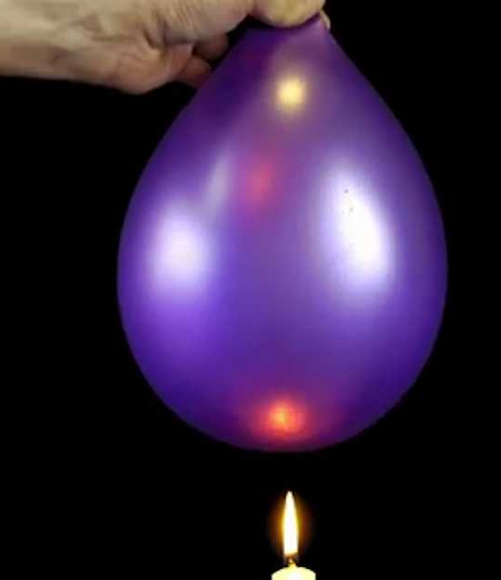
Activity-1 : Fire Water Balloon
Instructions:
Two inflated balloons are taken, inside one of the balloons water is filled.
Both the balloons are kept on a candle flame.
Comparison is drawn to the time taken by each balloon to burst.
Participants will note the observation and shall ask questions to understand the scientific knowledge behind it.
The activity is to be completed in 10mins.
Notes:
MTs shall ask the participants to share the observation for the demonstrated activity.
MTs shall take only balloons of similar colour.

Slide 4




How Is Scientific Temper Built?
Scientific Temper
Curiosity
Creativity
Why?
What?
How?
Critical Thinking

Slide 5








HOW IS SCIENTIFIC TEMPER Built?
Scientific Temper
Creativity
Critical Thinking
Ability to look for evidence and logic
Ability to think in new ways
Ability to reason
Focus Skills
These Skills cannot be
taught in isolation
Problem Solving
Collaboration
Empathy
Ability to Identify and give Solutions to a problem
Ability to seek help and work together
Ability to understand other perspectives Compassionately

Slide 6
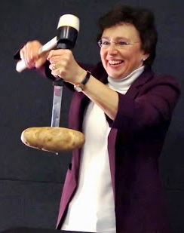

Activity-2: Anti - gravity motion
Take a knife and an apple or potato.
Insert the knife as shown in the picture.
Exert force on the head of the knife with hand or a hammer.
Observe the movement of the potato.
Notes:
MTs shall invite one volunteer to perform the activity with the instruction that he/she has to make the potato move through the knife upward without touching the potato.
If the participant succeeds then the MTs shall appreciate him/her. If not then the MTs shall demonstrate it.
MTs shall ask the participants to share their observations and establish the knowledge behind it.
MTs shall again emphasise on developing the mentioned skills through activities and demonstration.

Slide 7

SL NO | STATEMENT | FACT | MYTH
1 | Antibacterial soap is more effective than regular soap.
2 | Choosing the right soap for your skin type can help maintain skin hydration.
3 | Soap bars are less hygienic than liquid soap.
4 | It's essential to store soap bars in a dry location between uses to prevent bacterial growth.
5 | Natural or handmade soaps are always better than commercial soaps.
Notes:
Can create a Mentimeter link : https://www.menti.com/al4o3u23fas3

Slide 8
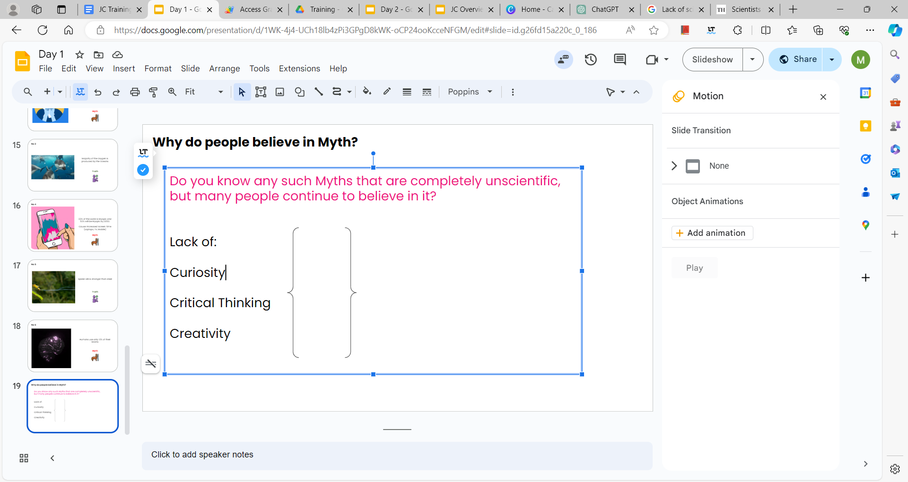
Why do people believe in Myths?
Do you know any such Myths that are completely unscientific, but many people continue to believe in them?
Lack of:
Curiosity
Critical Thinking
Creativity
What, Why and How: Ingredients for developing Scientific Temper
Learning science without scientific temper puts science education at risk

Slide 9


Learning skills vs Learning Knowledge
What’s the difference?
Learning Knowledge | Learning Skill
Collection of information (what & how) | Ability to do something
Knowing information makes you KNOWLEDGEABLE | Practice makes you SKILLED
And Scientific Temper is a
Knowledge
/ Skill
However, knowledge is the cornerstone of development and skills are an outcome of putting knowledge into practice.

Slide 10
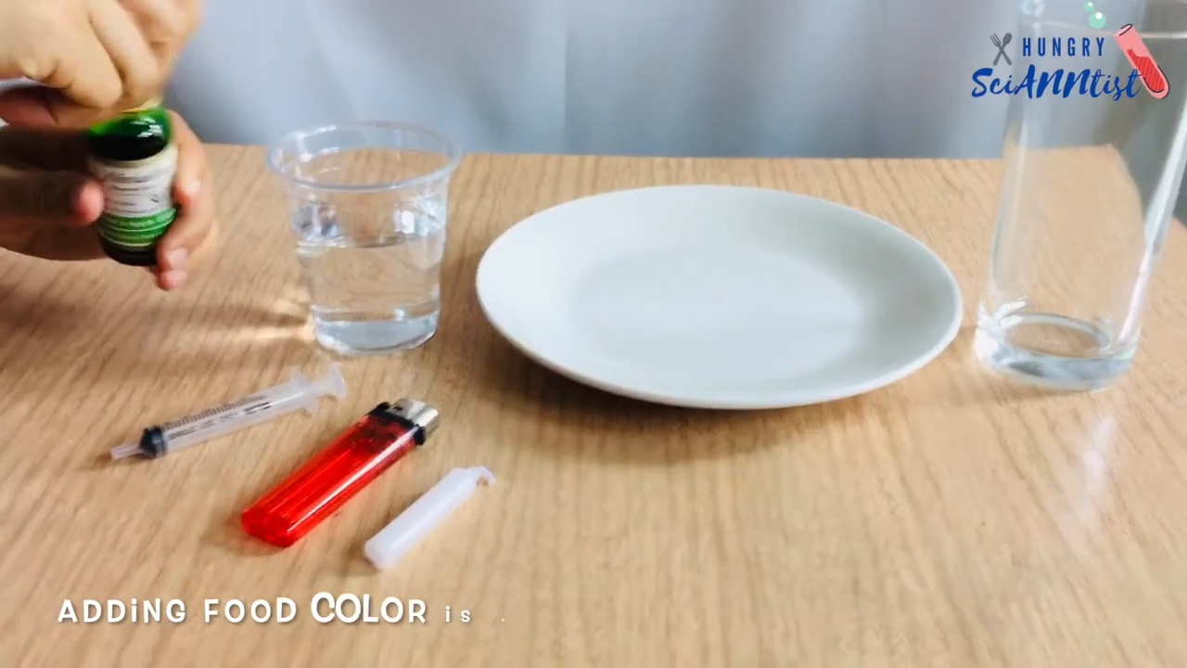
Notes:
MTs will show the video and shall ask the participants to draw their observations.
MTs will again emphasise on developing curiosity and scientific temper through Hands-on-activity.

Slide 11



What are the three ingredients?
The Jigyansa Curriculum seeks to mix these three ingredients to inculcate these focus skills in students
Knowledge
Power of examples
Activity based
Critical Thinking
Scientific
Temper
Creativity
Problem
Solving
Empathy
Collaboration
Notes:
MTs shall ask the participants to relate the three ingredients of Jigyansa by giving examples.

Slide 12
THANK YOU!
All the best Jigyansa Teachers.

