Slide 1




BLOCK LEVEL TEACHER
TRAINING WORKSHOP ON
‘JIGYANSA’
Knowledge Partner:
Organised By:
UNICEF State Office for Odisha,
Inqui-Lab Foundation & Odisha Biodiversity Board
Mo School Abhiyan Parichalana Sangathan,
Government of Odisha

Slide 2

Objective:
Build clarity on the approach of Knowledge - Examples - Play

Slide 3



KNOWLEDGE
Newton’s Third law of motion
For every action, there is an equal and opposite reaction.

Slide 4


VIDEO

Slide 5
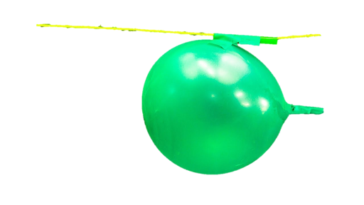
PLAY
Create balloon rockets. Attach a balloon to a straw on a string, inflate it, and let it go. Observe the reaction force propelling the balloon forward.

Slide 6
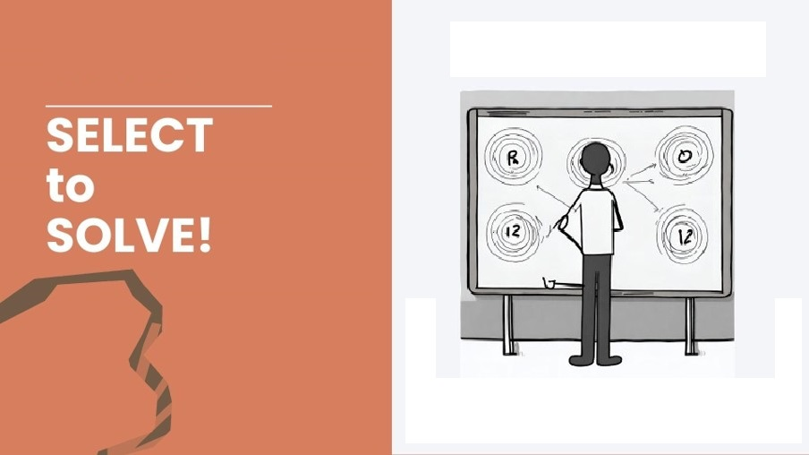
Notes:
Trainer shall assign each group a problem on which the participants shall develop a play ( an activity such as myth & facts, a demonstration )

Slide 7
ପ୍ରଦୂଷଣ ଇତ୍ୟାଦି କାରଣରୁ ଅନେକ ପକ୍ଷୀ ବିପଦରେ ପଡୁଛନ୍ତି ଏବଂ ବିଲୁପ୍ତ ହେଉଛନ୍ତି

Slide 8

Notes:
Trainer shall assign the proble

Slide 9

Group Activity
Notes:
MTs shall ask the participants to think of Knowledge –Example –Play and design an activity using the resources supplied to them or available with them.
Participants will brainstorm their ideas.
MTs shall distribute the resources among the groups.

Slide 10
Group Presentation
(Each Group 5mins)

Slide 11
BENEFITS OF INTEGRATING KNOWLEDGE, EXAMPLES, AND PLAY.
Deeper Understanding: Students grasp concepts more thoroughly by seeing and doing, which solidifies theoretical knowledge.
Engagement and Motivation: Practical activities make learning more engaging and fun, increasing student interest and motivation.
Critical Thinking and Problem Solving: Hands-on activities require students to apply their knowledge, fostering critical thinking and problem-solving skills.

Slide 12
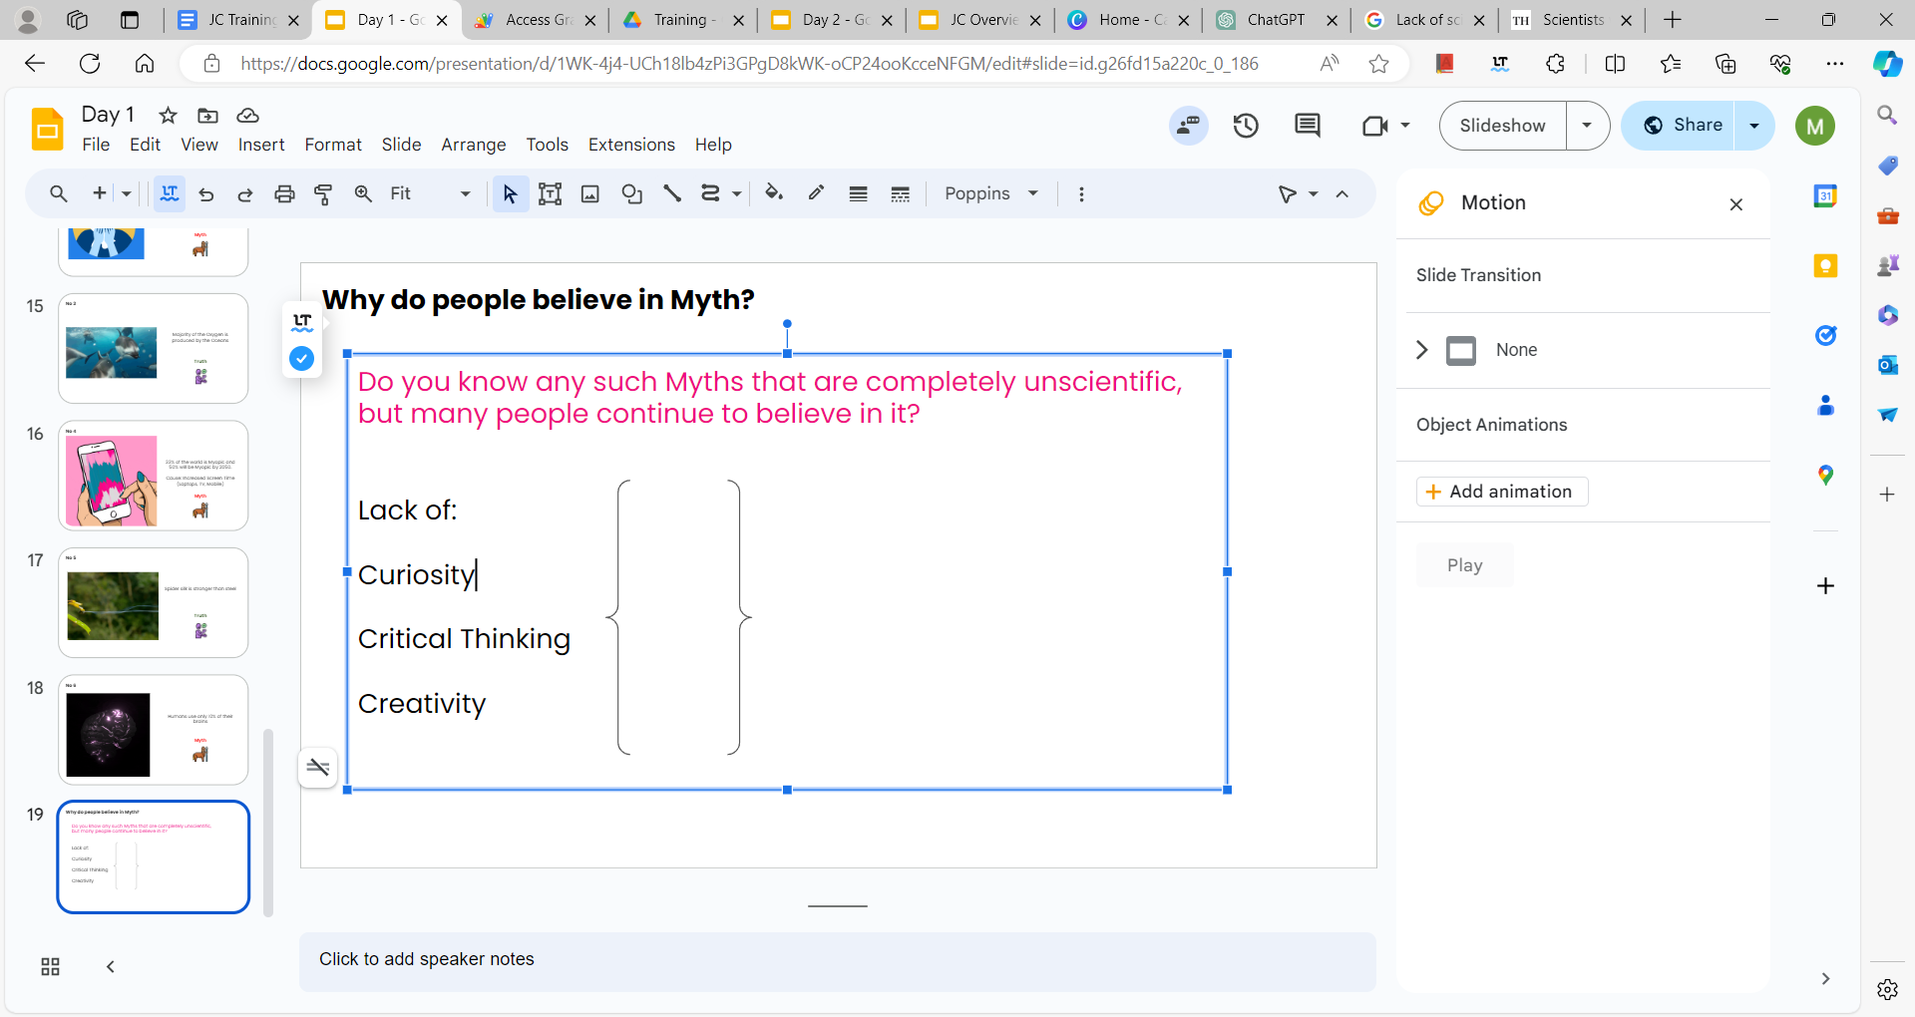









What are the three ingredients?
The Jigyansa Curriculum seeks to mix these three ingredients to inculcate these focus skills in students
Knowledge
Power of examples
Activity based
Critical Thinking
Scientific
Temper
Creativity
Problem
Solving
Empathy
Collaboration
Notes:
MTs shall ask the participants to relate the three ingredients of Jigyansa.

Slide 13
THANK YOU!
All the best Jigyansa Teachers.

