Slide 1




BLOCK LEVEL TEACHER
TRAINING WORKSHOP ON
‘JIGYANSA’
Knowledge Partner:
Organised By:
UNICEF State Office for Odisha,
Inqui-Lab Foundation & Odisha Biodiversity Board
Mo School Abhiyan Parichalana Sangathan,
Government of Odisha

Slide 2
DAY 2 – UNIT-1

Slide 3

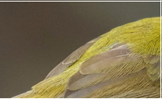
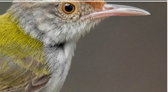
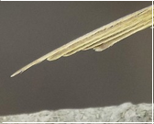

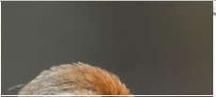



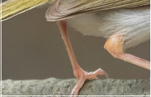
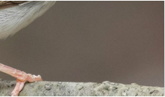

Let’s arrange it
Notes:
Group Activity:
Distribute the puzzle among the groups.
Ask them to arrange it & paste it on the A4 size paper
Tell them to identify the bird and share its name.

Slide 4

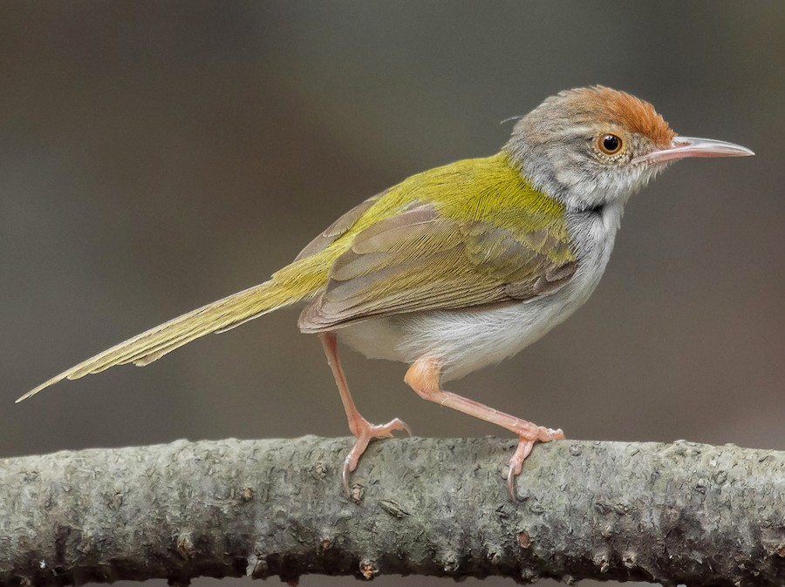
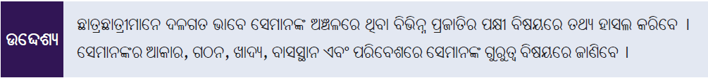

Slide 5
What is birding ? Birdwatching ? Birdwatcher ?
Notes:
Introduction. Teacher Activity 1 : (8 mins)
1. Tell that birds is an important topic for Jigyansa, and aligned to the Biodiversity reference book. Tell participants that we are going to understand a few things about birds, and how to do the project - bird diary.
2. Ask people in the group to read the first line in the ppt. And ask what do they understand by birding.
3. Take multiple responses from participants across different corners of the room. Ensure giving time for their response. Facilitator speaks less.
4. Tell them birding or birdwatching mean the same. It is the activity of observation of birds and behavior. It is a hobby. And the person who does bird watching is called a ‘birdwatcher’.
Whole Class Activity - Names of bird (10 mins)
Tell ‘we are going to do a small activity now. You need to share the name of one bird you know. Others will try to not repeat the name of that bird in their turn’
Tell the group to listen to the names of the birds. Ask ‘what do birds do when you make noise ? ‘ Wait for someone to say ‘birds will fly away’ . Emphasise that when talking about birds we have to be silent ( so that birds don't fly away) . And attentive ( so that we can hear birds)
Pick a side in the class and ask the participant to start naming a bird. Tell that they can name the bird in any language - english, hindi, odia.
Ask the next person to name. ( Facilitator does not speak much in between)
If people speak out of their turn, gently remind them that their turn is over, or is yet to come.
After everyone in the group shares the names, tell the group that as a group they shared around 40 new bird names (or the number based on workshop strength) . And that they already know a lot of birds.

Slide 6
BIRDS & CHARACTERISTICS
SHARE SOMETHING ABOUT THE BIRDS YOU SHARED THE NAMES OF.
HOW DO YOU IDENTIFY THE BIRD ? WHAT ARE THE CHARACTERISTICS BY WHICH FIND FIND OUT THE BIRD?
Notes:
C. Teacher Activity 2 :

Slide 7
BIRDING - CHARACTERISTIC - CALLS, SOUND
SHARES THE CALL OF ONE BIRD
Notes:
2 mins to think. 3 mins to share

Slide 8
BIRDING - TRACK THE BIRD
YOU SEE THE BIRD WITH EARS
TUNE THE EARS TO THE CALLS OF BIRDS BY BEING SILENT, AND PAYING ATTENTION

Slide 9
INDIAN BIRD CALLS

Slide 10
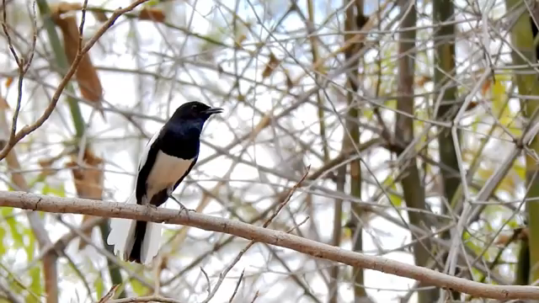
Notes:
Forward the video after each bird ( 5 mins) + another video - 5 mins

Slide 11
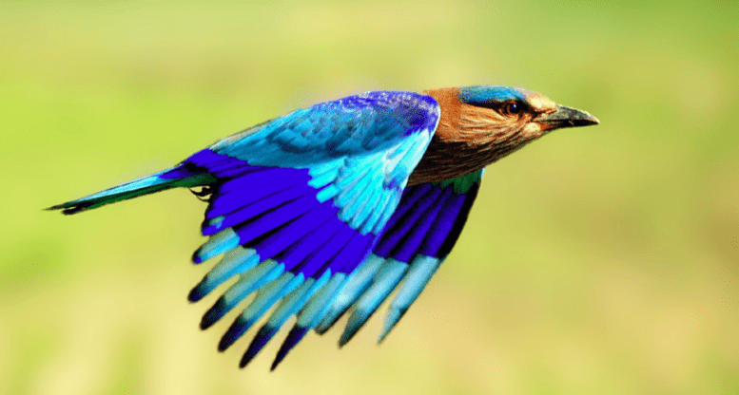
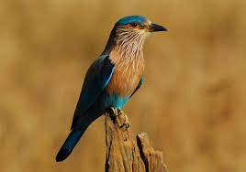
NAME THE BIRD. WHERE DID YOU SEE IT?
Notes:
Name the bird. Guess what is special about it ? Where did you see this bird?
State bird of Odisha and Telangana ( Indian Roller)

Slide 12
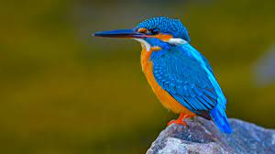
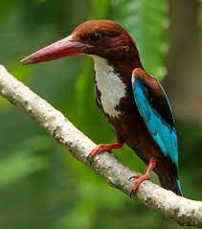
NAME THE BIRD . WHERE DID YOU SEE?
Notes:
Guess the name of the bird. Where did you see this bird ?
What do you think is the difference between these birds

Slide 13
CHARACTERISTICS OF BIRDS
HABITAT - THE PLACE WHERE THEY ARE FOUND
CALL/SOUND
COLOUR
GENDER
FOOD THEY EAT - HOW WILL THE BEAK BE IF THEY DRINK HONEY, IF THEY EAT SEEDS, IF THEY EAT FISH, OTHER BIRDS (BIRDS OF PREY)
PLACES WHERE THEY NEST
BREEDING SEASON

Slide 14
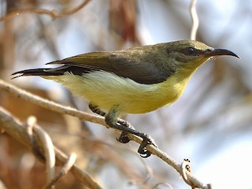
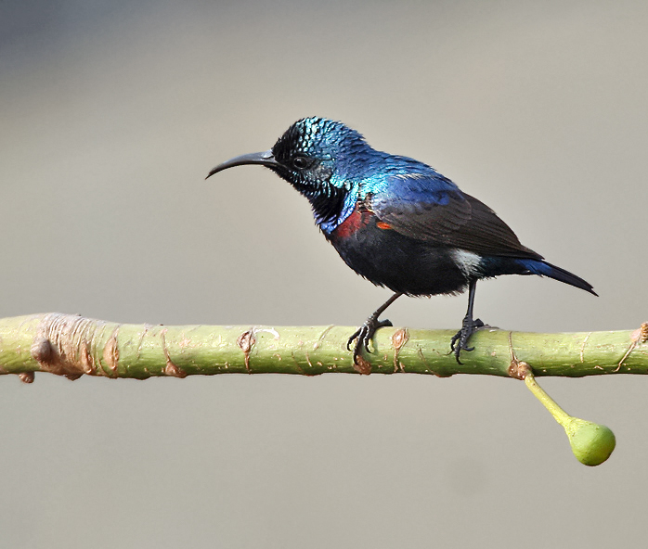
Notes:
Male & female comparison : looking different
Male is attractive & colorful

Slide 15
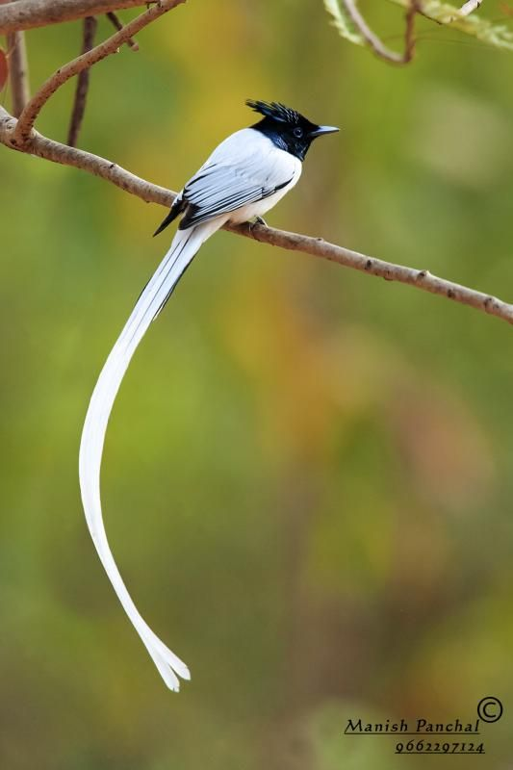
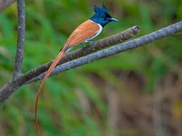
Notes:
Male & female comparison : looking different
Male is the attractive & colorful
White – male , brown - female

Slide 16
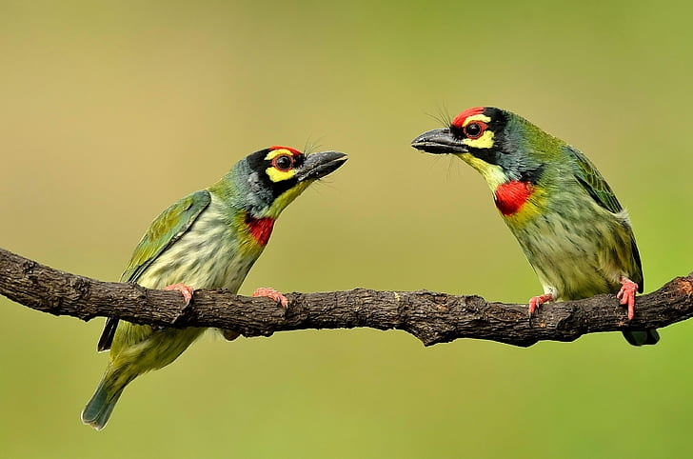
Notes:
Male & female comparison : looking similar

Slide 17
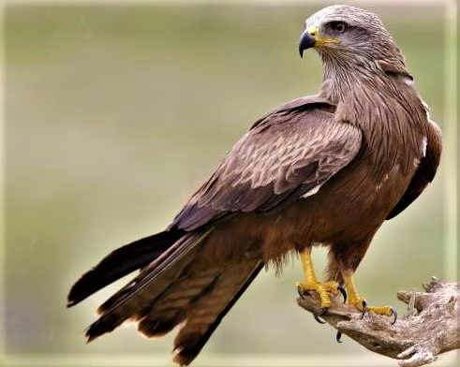
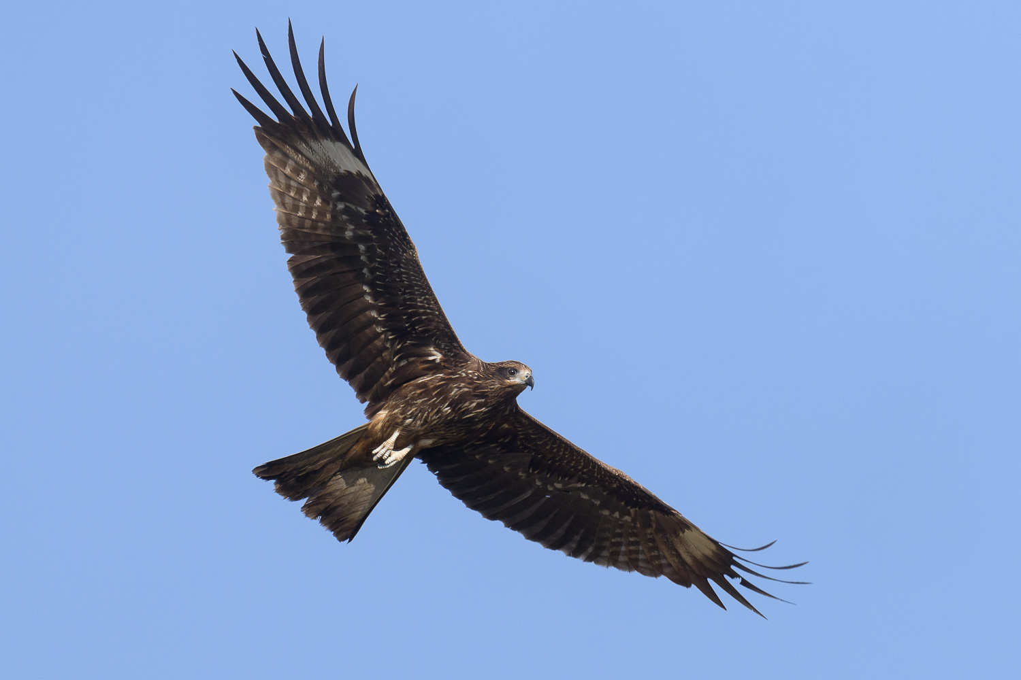
Notes:
Bird – Black kite (Prey bird)
Focus on shape of the beak
Used for tearing flesh

Slide 18
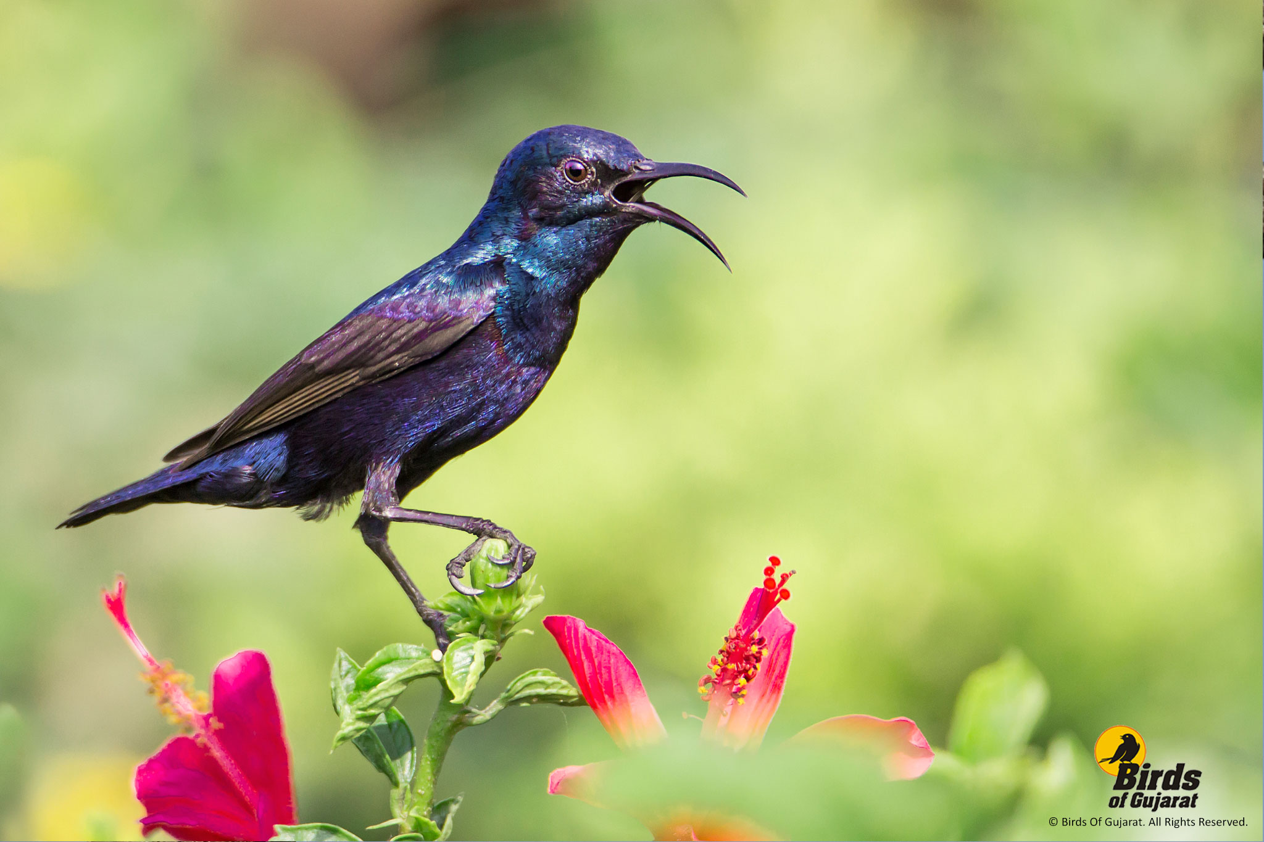
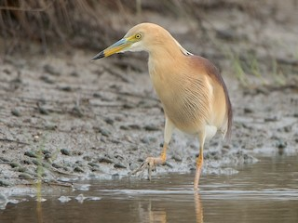
Purple sunbird
Pond heron
Notes:
Beak size comparisons
Sunbird nectar collection
Heron – fish hunting

Slide 19
ACTIVITIES AND PROJECTS IN CLASS - UNIT 1 - BIRD DIARY
ACTIVITY 1 : CREATE A BIRD DIARY OF BIRDS AROUND YOU, WRITE THE CHARACTERISTICS OF THEM - INCLUDING SOUND, COLOUR, HABITAT (PLACES THEY ARE FOUND), FOOD, BEHAVIOR THROUGH OBSERVATION.
HOW WILL YOU MAKE STUDENTS DO THIS IN CLASS ( DISCUSS IN GROUP FOR 2 MINS, 1 PERSON SHARE FROM EACH GROUP)
Notes:
Ask if they have any questions of how this will be conducted in classroom?

Slide 20
BIRD DIARY - HOW TO? CREATE INTEREST - WHAT DO THEY KNOW?
CREATE INTEREST ABOUT BIRDS IN THE STUDENTS.
MAKE THEM SHARE WHAT THEY KNOW ABOUT BIRDS BY ASKING QUESTIONS
ASK THEM TO SHARE CHARACTERISTICS OF THE BIRDS THROUGH QUESTIONS LIKE:
  WHAT IS THE COLOUR?
  HOW DO THE MALE AND FEMALE LOOK?
  WHERE DO THEY KEEP THEIR NEST?
  WHAT IS THE COLOUR OF EGGS?
  WHAT DO THEY EAT AS FOOD?
  HOW ARE THEIR BEAKS?
  HOW DO THEY MAKE BIRD CALLS?

Slide 21
BIRD DIARY - ADDITIONAL KNOWLEDGE - FOR OBSERVATION
YOU SEE BIRDS WITH EYES, AND ALSO WITH EARS.
EASIER TO SPOT BIRDS EARLY IN THE MORNING, AND BEFORE SUNSET WHEN THE LIGHT IS PLEASANT.
DIFFERENT HABITATS WILL HAVE DIFFERENT BIRDS - WATER, DRY LAND, FLOWERS, BUSHES, GARBAGE, TOP OF THE TREES, FRUIT TREES, LAND WHERE THEY NEST.
BIRDS ARE SENSITIVE. WE HAVE TO BE SILENT AND INVISIBLE TO THE BIRD
NEVER DISTURB THE NEST OF THE BIRD. DON’T HARM THE BIRD.
SAFETY IS PRIORITY. WEAR PROPER FOOTWEAR. BE AWARE OF SNAKES, SCORPIONS, QUICK SAND, HILLY SLOPES, WATER DEPTH ETC
BIRDS HAVE TERRITORY. THE BIRDS KEEP VISITING THE SAME PLACE REPEATEDLY. STARTING FROM FEW BUSHES TO DIFFERENT CONTINENTS - BUT THEY REPEAT

Slide 22
BIRD DIARY - ADDITIONAL KNOWLEDGE - FOR OBSERVATION
TAKE THEM AROUND YOURSELF IN THE IMMEDIATE SURROUNDINGS. THERE ARE BIRDS ALL AROUND. MAKE THEM TAKE NOTES.
GUIDE THEM WITH COLUMNS/TABLES - COLOUR, SOUND, FEATURES , SIZE OF BIRD, HABITAT FOUND
ASK THEM TO OBSERVE AND MAKE A CLEANER RECORD WITH EVEN DRAWINGS .
PERIODICALLY, ONCE IN 3 WEEKS, ASK THEM TO SHOWCASE DURING THE PROJECT DISCUSSION SESSION (20 mins)
MAKE THEM SIT IN GROUPS AND SHARE THEIR NOTES AND DISCUSS THEIR OBSERVATIONS
APPRECIATE WHAT THEY HAVE DONE.
IN YOUR NOTE BOOK START OBSERVING BIRDS AND MAKE A DIARY IN THE NEXT 3 DAYS

Slide 23

THANK YOU!
All the best Jigyansa Teachers.

