Slide 1




BLOCK LEVEL TEACHER
TRAINING WORKSHOP ON
‘JIGYANSA’
Knowledge Partner:
Organised By:
UNICEF State Office for Odisha,
Inqui-Lab Foundation & Odisha Biodiversity Board
Mo School Abhiyan Parichalana Sangathan,
Government of Odisha

Slide 2
SESSION-4
Objective: Demo of Session plan transaction

Slide 3
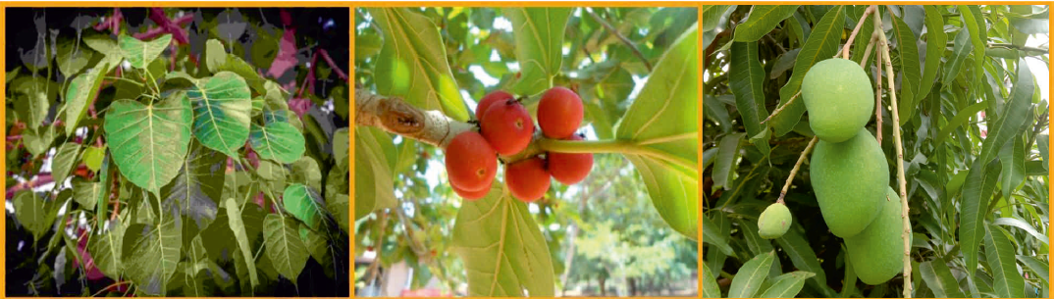
Notes:
MTs shall distribute leaves of 5-10 trees/plants grows in the locality among the participants(or students) and ask them to name the trees & write one use of it.
The MTs shall paste the leaves on a A4 size paper . They will write the name and one use of it on the paper using Sketch pen.

Slide 4
ଉଦ୍ଦେଶ୍ୟ
Notes:
Objective of the session plan must be drawn from the participants based on their observation during the opening activity.
Objective shall NOT be disclosed or declared by the MTs before carrying out the opening activity.

Slide 5
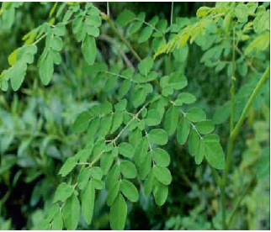
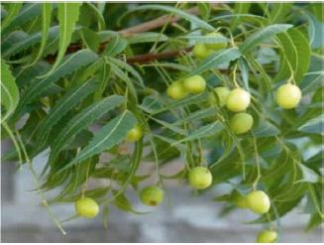


Notes:
MTs shall try to build and extract more knowledge from the participants.
Participants shall be asked to tell the uses of the highlighted part of the trees shown on the screen.
MTs can show a video/documentary on the rarely found or extinct trees of their region to develop empathy among the Participants.
Maximum 10mins shall be utilized by the MTs to deliver this part of the session.

Slide 6
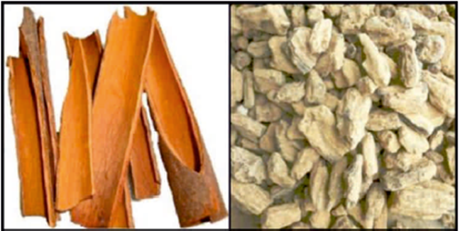


Slide 7
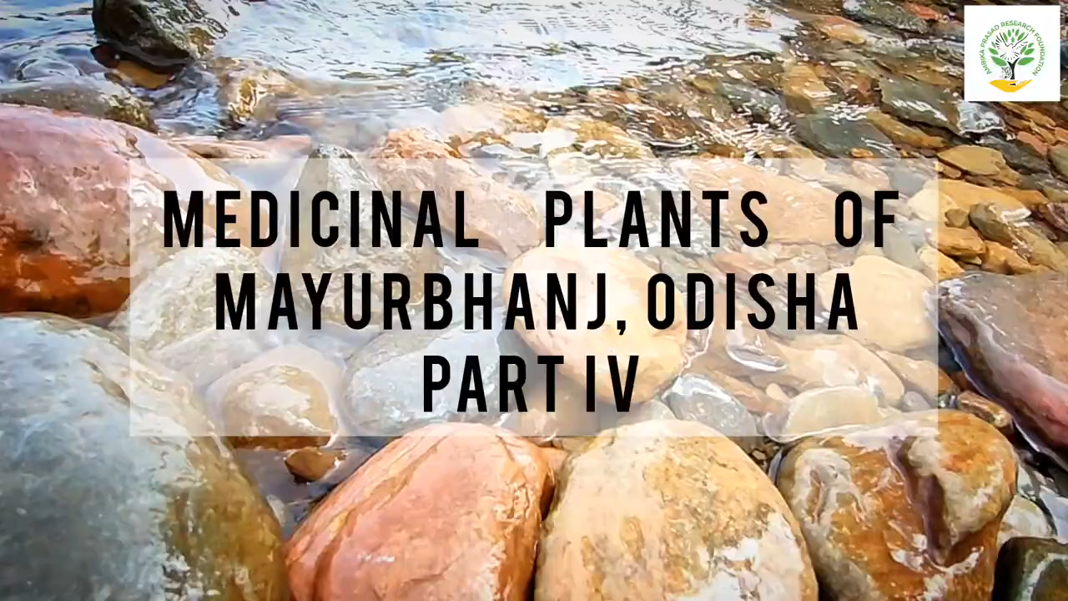

Slide 8

Notes:
MTs shall assign the participants to list 5 trees/plants found in their areas and make table to indicate their social/ economical /medicinal use.
A maximum of 7-10 mins shall be utilized to complete task.

Slide 9
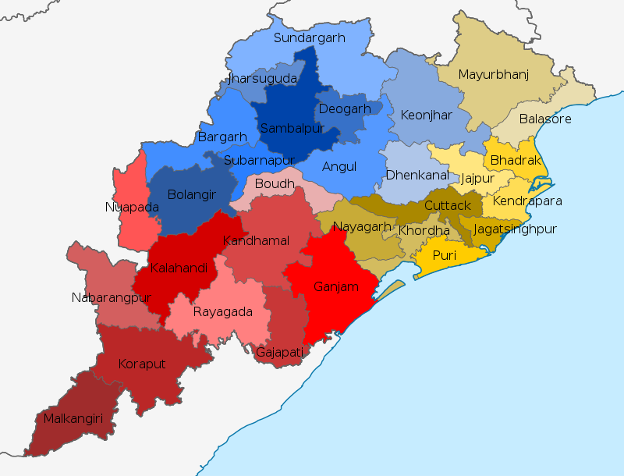

Slide 10


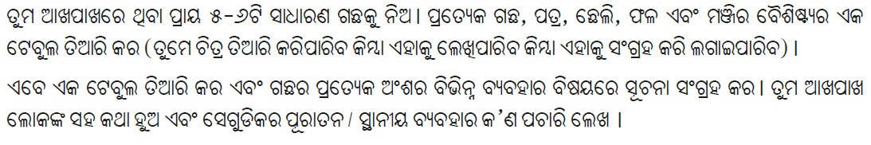
Notes:
MTs shall brainstorm on ways to create a plant diary.
MTs shall share their ideas orally/ through sticky notes.
A maximum of 10mins shall be used to complete the task.

Slide 11
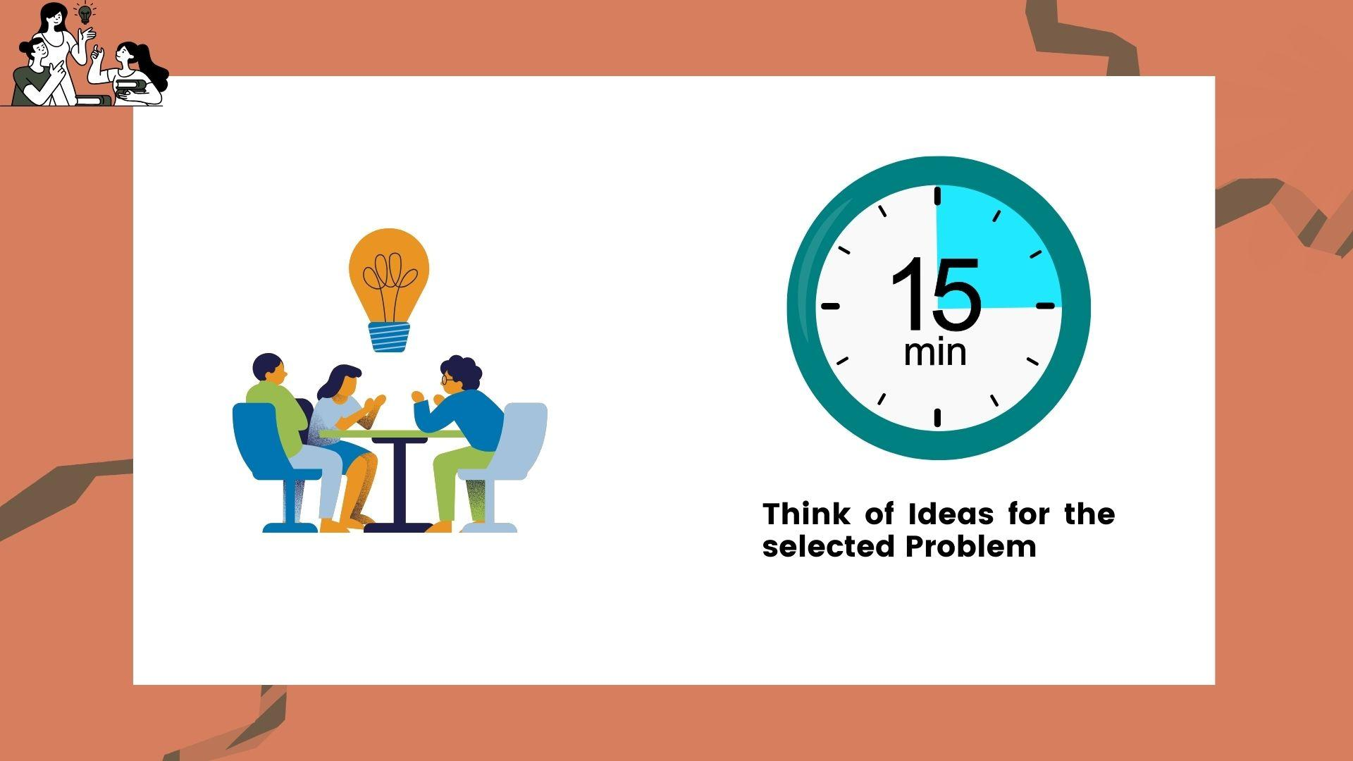

Slide 12

THANK YOU!
All the best Jigyansa Teachers.

