Slide 1




BLOCK LEVEL TEACHER
TRAINING WORKSHOP ON
‘JIGYANSA’
Knowledge Partner:
Organised By:
UNICEF State Office for Odisha,
Inqui-Lab Foundation & Odisha Biodiversity Board
Mo School Abhiyan Parichalana Sangathan,
Government of Odisha

Slide 2
SESSION-6
Objective: Ideate and develop presentations on session topics discussed in Unit-1, i.e. Biodiversity

Slide 3
Choose a DIY topic from all sessions in Unit 1 (Birds, Plants, Mammals) & mode of presentation on the basis of lottery
(Mode of presentation : storyboard, role-play & sketch)

Slide 4
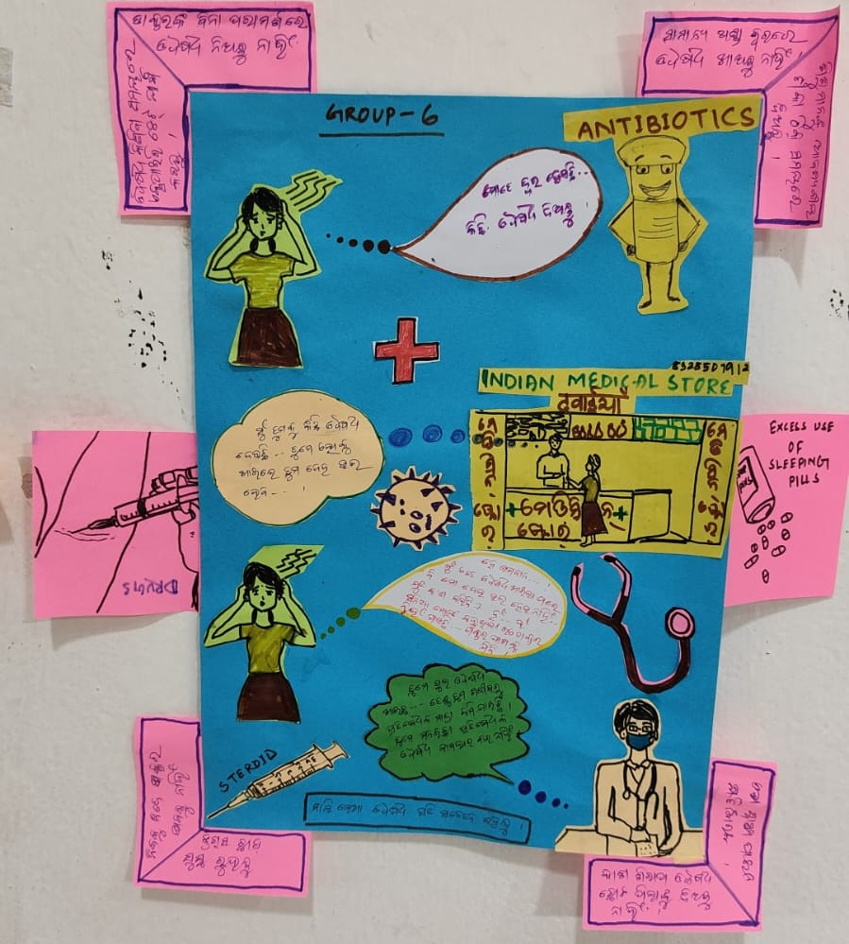
Story
Boarding

Slide 5
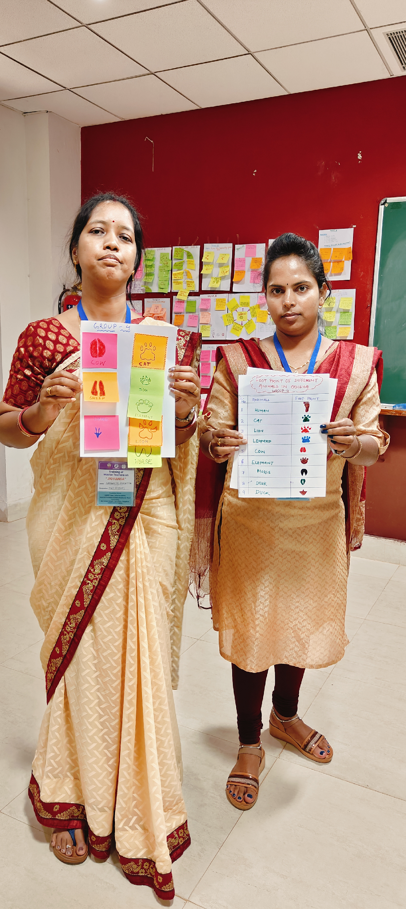
Sketch Prototype

Slide 6
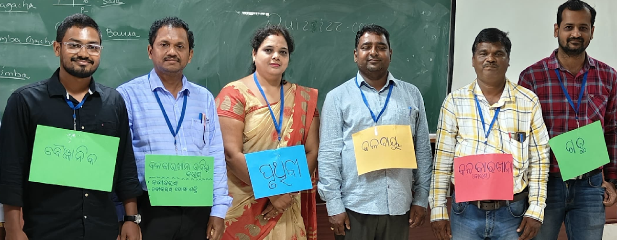
Roleplay

Slide 7


Slide 8
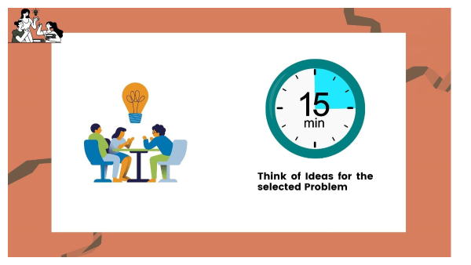

Slide 9
Activity: Group Presentation
Presentation : 4 minutes & feedback: 2 minutes
Each Group

Slide 10

THANK YOU!
All the best Jigyansa Teachers.

