Slide 1


Workshop of Master Trainers
On
‘JIGYANSA’

Slide 2
Introduction to Prototyping Techniques
Notes:
MTs shall introduce the objective of the session through examples.
MTs shall try to draw the conclusion from the examples that solutions to a project problem can have two type of solution, product or process.

Slide 3
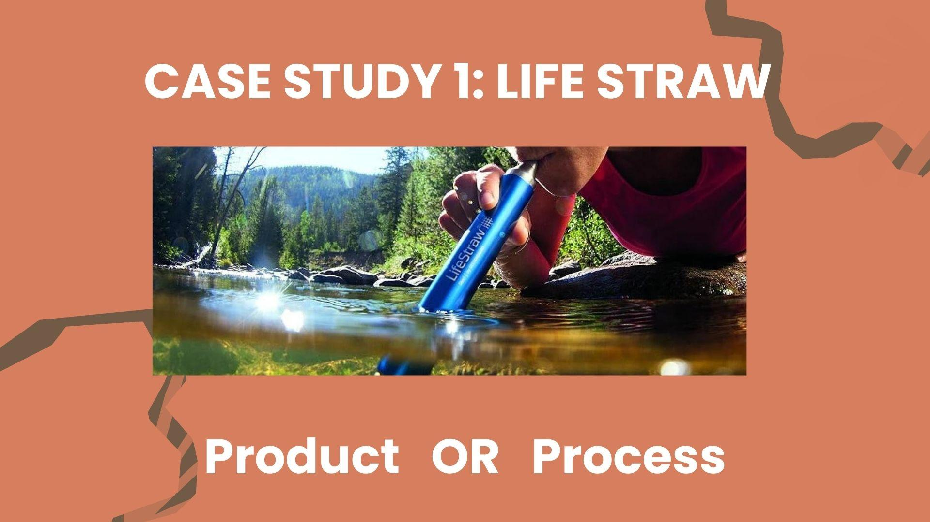
Notes:
MTs shall ask the participants to categories the solution as product or process.
MTs shall explain the use of the innovative product.

Slide 4
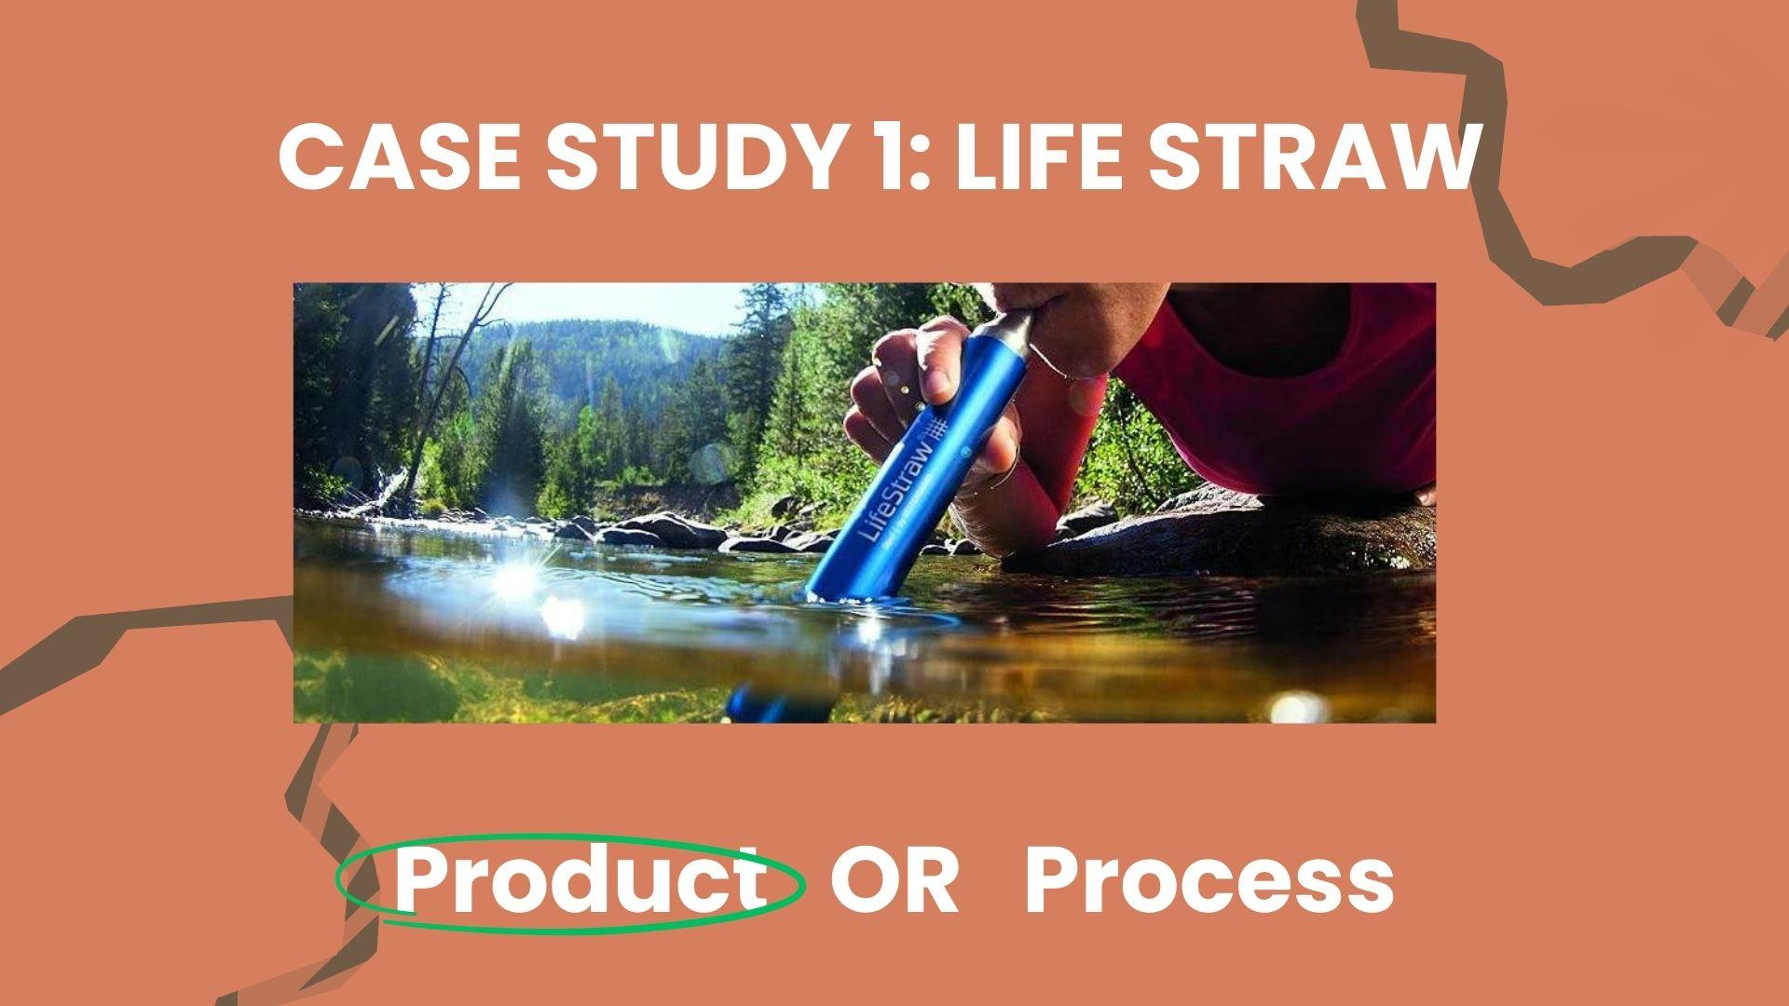

Slide 5

Notes:
MTs shall ask the participants to categories the solution as product or process.
MTs shall explain why the above is a process not a product.

Slide 6


Slide 7


Slide 8


Slide 9
Discuss :
Can you think of what kind prototype is best for each of these? Why?
Working Prototype
Non Working Prototype
Sketch Prototype
Storyboarding
Notes:
MTs shall introduce different techniques of prototyping by giving examples.
Discussion shall be done on working and non-working prototype.

Slide 10
Discuss :
Can you think of what kind prototype is best for each of these? Why?
Working Prototype
Non Working Prototype
Sketch Prototype
Storyboarding

Slide 11
Discuss :
Can you think of what kind prototype is best for each of these? Why?
Working Prototype
Non Working Prototype
Sketch Prototype
Storyboarding

Slide 12
Instructions
STEP 1 :
Pick up the Lesson plans of the Unit that has been assigned to your team.
STEP 2:
As a team, go through the 3 lesson plans in that Unit and the 2 problems given at the end of each Session Plan
STEP 3 :
Pick one of the problems to work on.

Slide 13
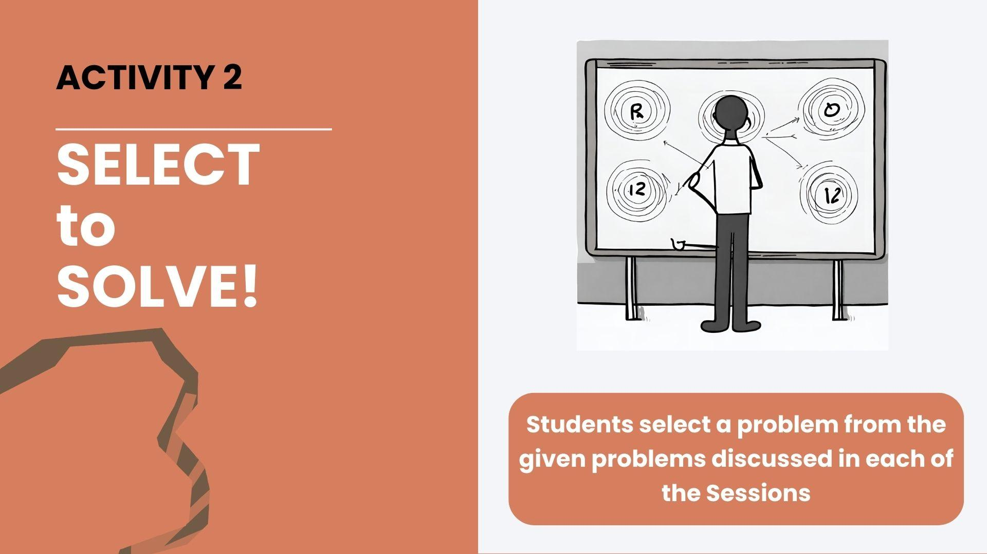

Slide 14


Slide 15


Slide 16
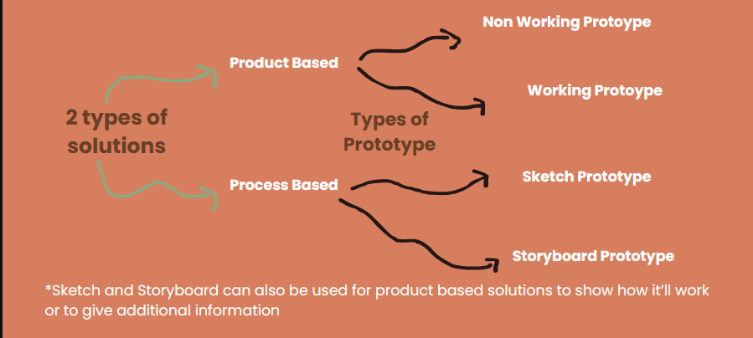
Types of Prototypes

Slide 17
Activity : Team Presentations

Slide 18







Recall : Jigyansa : What is our Objective?
To Nurture Curiosity and Innovation through Project-Based Learning
Scientific Temper
Creativity
Critical Thinking
Ability to look for evidence and logic
Ability to think in new ways
Ability to reason
Focus Skills
These skills cannot be taught in isolation
Problem Solving
Collaboration
Empathy
Ability to identify and give solutions to a problem
Ability to seek help and work together
Ability to understand other perspectives compassionately

Slide 19
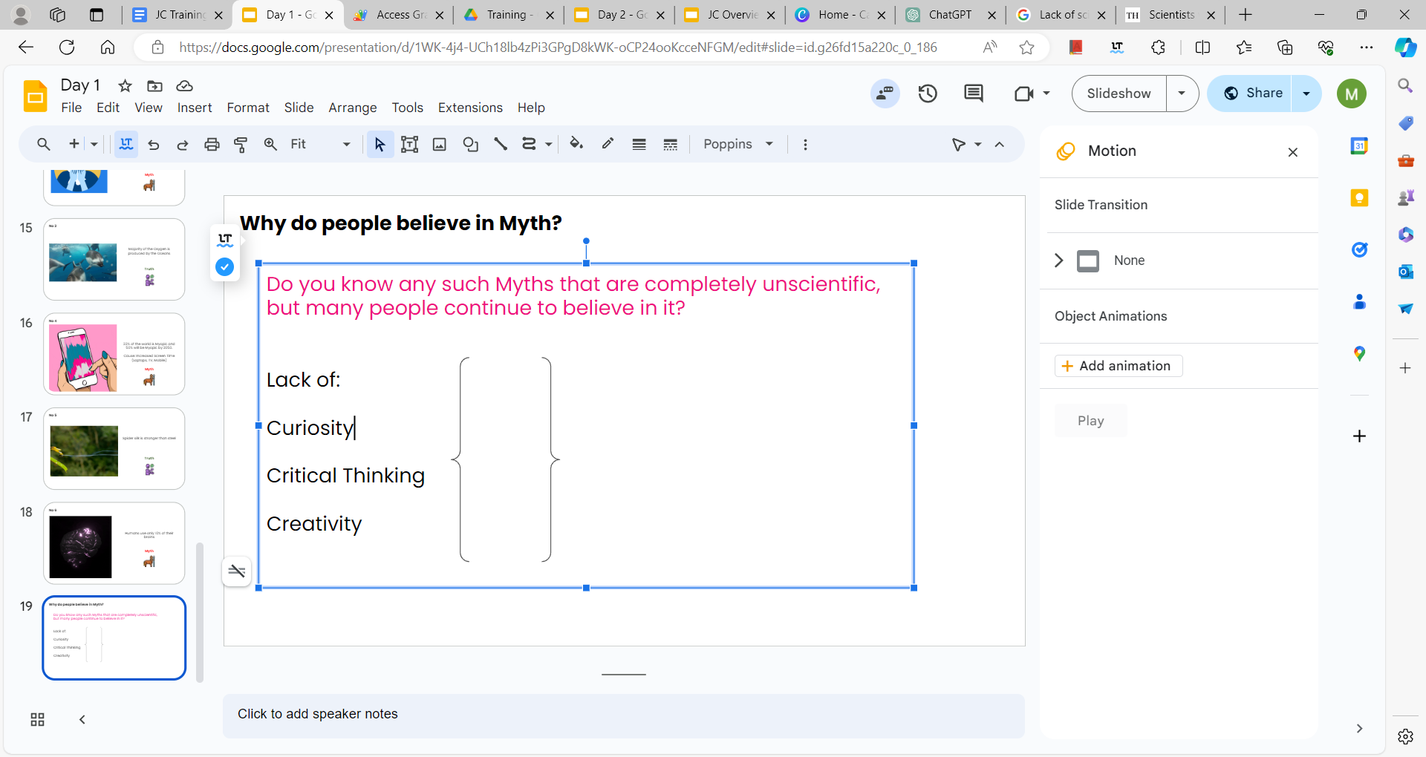



What are the three ingredients?
Jigyansa seeks to mix these three ingredients to inculcate the focus skills in students
Knowledge
Power of examples
Activity based
Critical Thinking
Scientific
Temper
Creativity
Problem
Solving
Empathy
Collaboration

