Slide 1




BLOCK LEVEL TEACHER
TRAINING WORKSHOP ON
‘JIGYANSA’
Knowledge Partner:
Organised By:
UNICEF State Office for Odisha,
Inqui-Lab Foundation & Odisha Biodiversity Board
Mo School Abhiyan Parichalana Sangathan,
Government of Odisha

Slide 2
ପ୍ରାରମ୍ଭିକ ଶିକ୍ଷଣ କାର୍ଯ୍ୟ
ଖଣ୍ଡ -୫

Slide 3
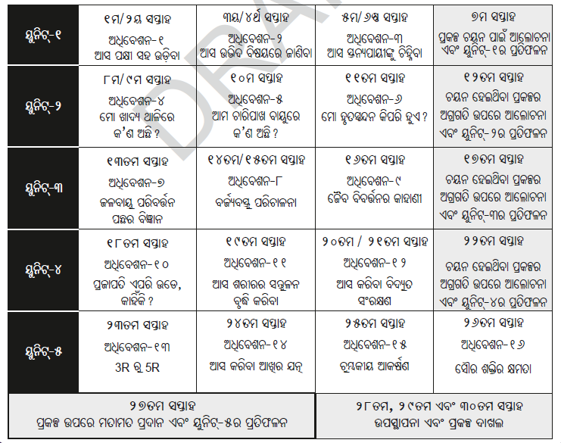

Slide 4
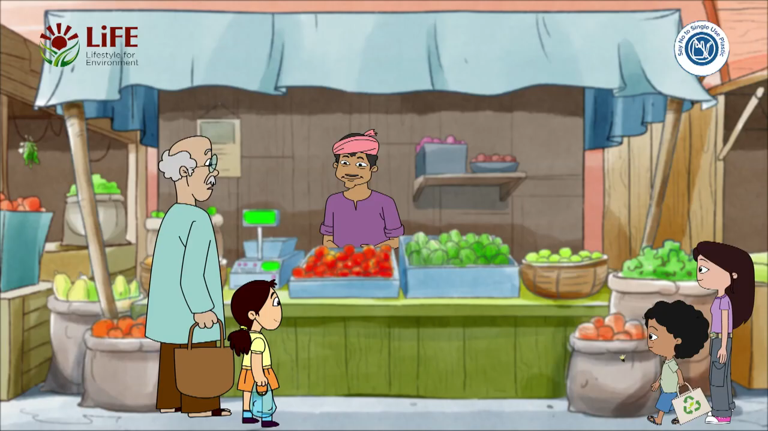

Slide 5
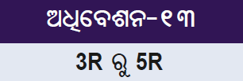
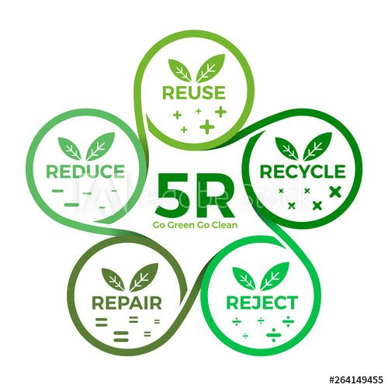
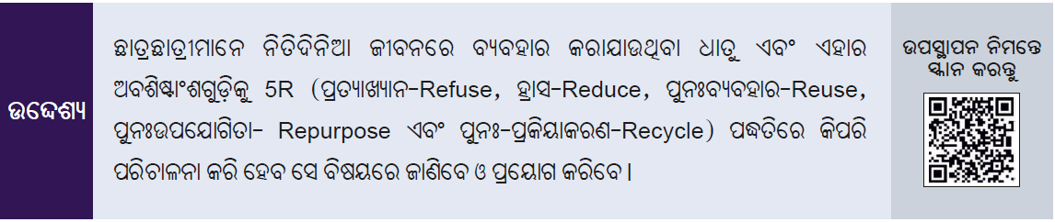

Slide 6
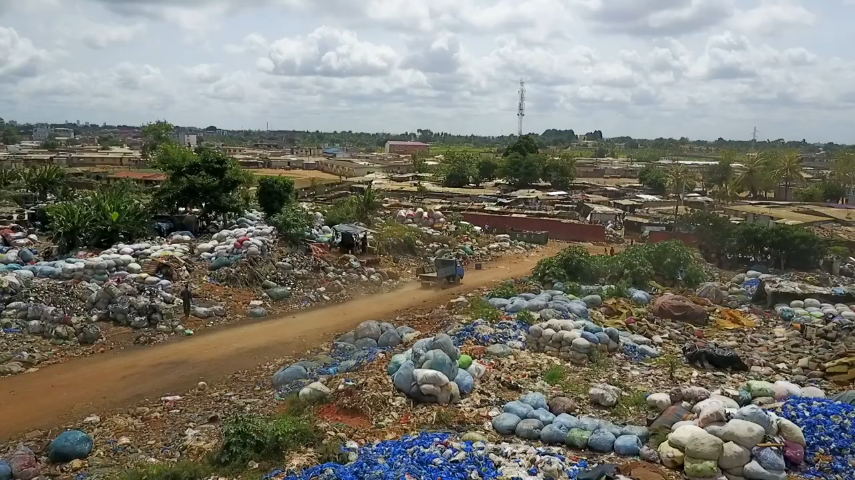

Slide 7
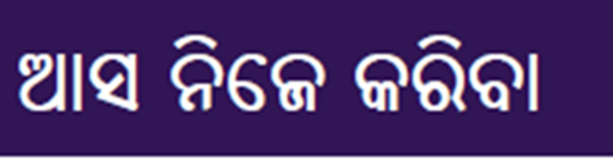
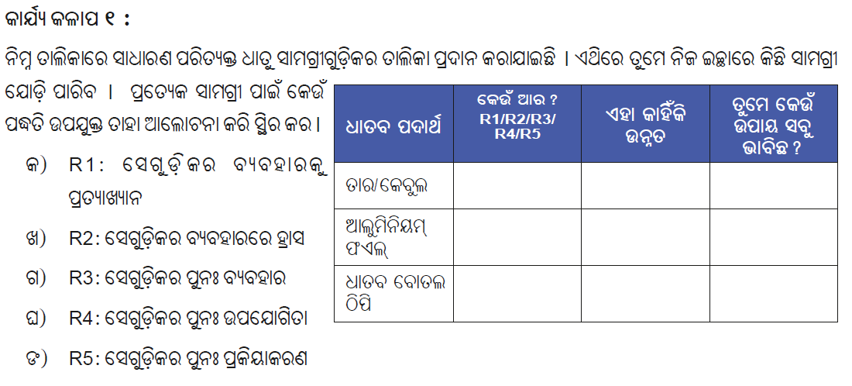

Slide 8
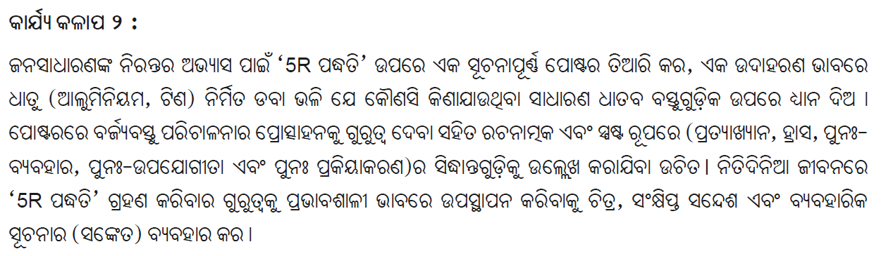

Slide 9
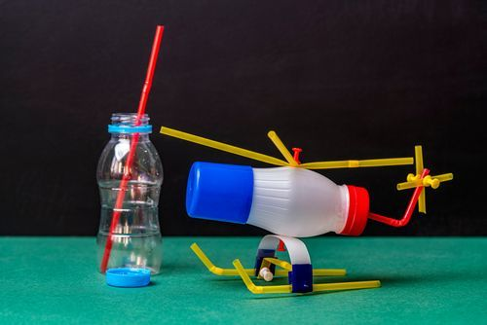


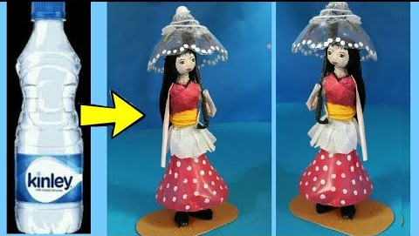

Slide 10


Slide 11





Slide 12

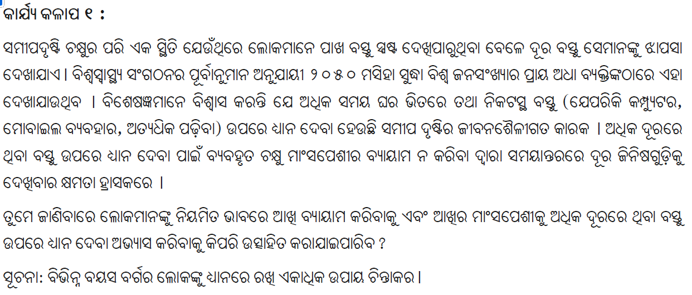

Slide 13
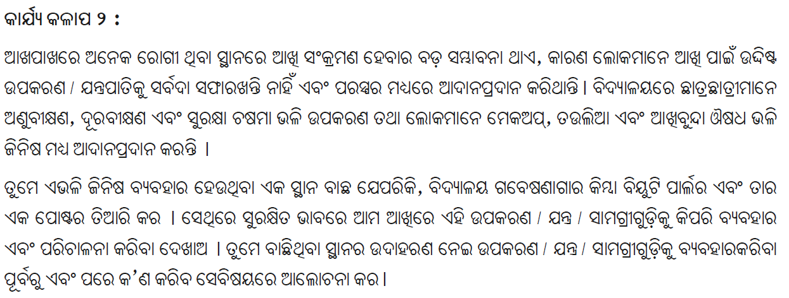

Slide 14
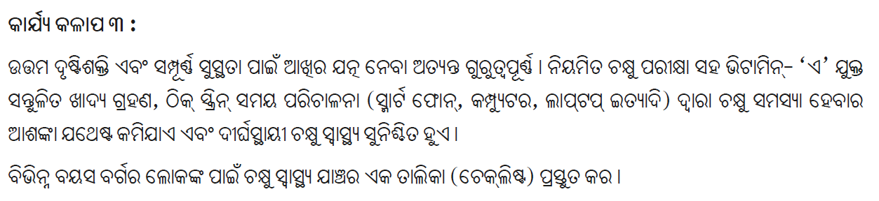

Slide 15
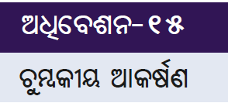
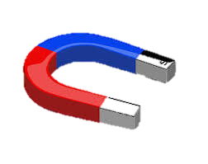
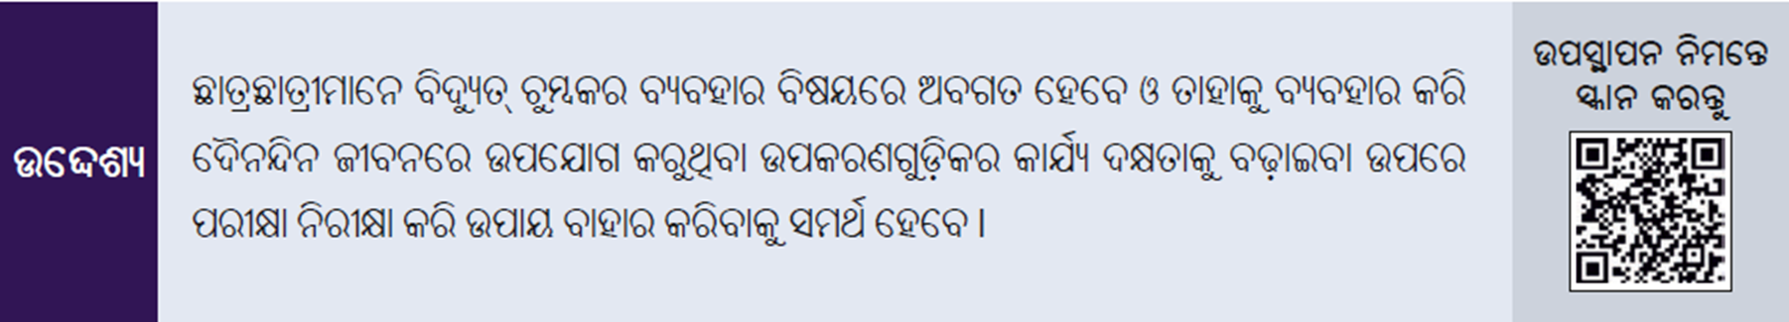

Slide 16

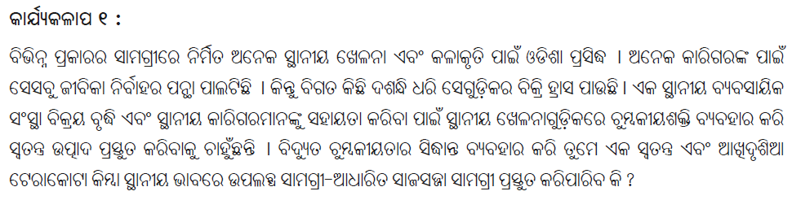

Slide 17

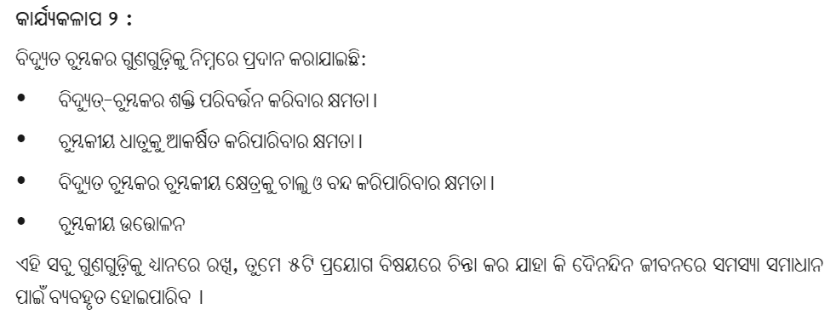

Slide 18
WHICH OF THE FOLLOWING IS THE PRIMARY COMPONENT USED IN MOST SOLAR PANELS TO CONVERT SUNLIGHT INTO ELECTRICITY?
A) COPPER
B) SILICON
C) GRAPHENE
D) ALUMINUM
Silicon

Slide 19
What is the term for the device that converts direct current (DC) generated by solar panels into alternating current (AC) used by most home appliances?
A) CONVERTER
B) RECTIFIER
C) INVERTER
D) TRANSFORMER
Inverter

Slide 20
Which of the following is an advantage of using solar energy?
A) It is non-renewable.
B) It produces greenhouse gases.
C) It reduces electricity bills.
D) It relies on fossil fuels.
It reduces electricity bills.

Slide 21
What is the typical efficiency range of commercially available solar panels?
A) 5-10%
B) 15-20%
C) 25-30%
D) 35-40%
15-20%

Slide 22
Which of the following countries has the highest installed capacity of solar power as of 2023?
A) United States
B) Germany
C) India
D) China
China

Slide 23
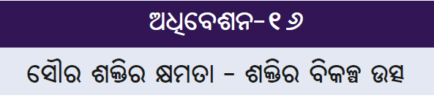
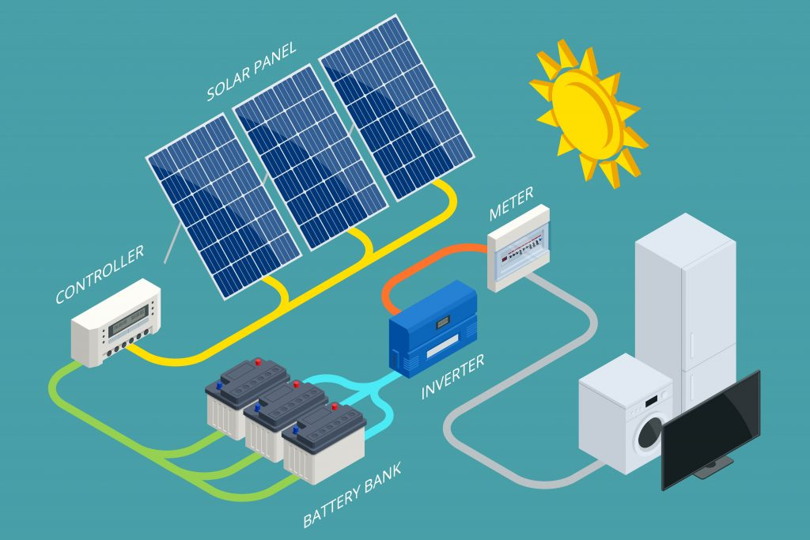
Notes:
1. of the cells used in solar panels

Slide 24


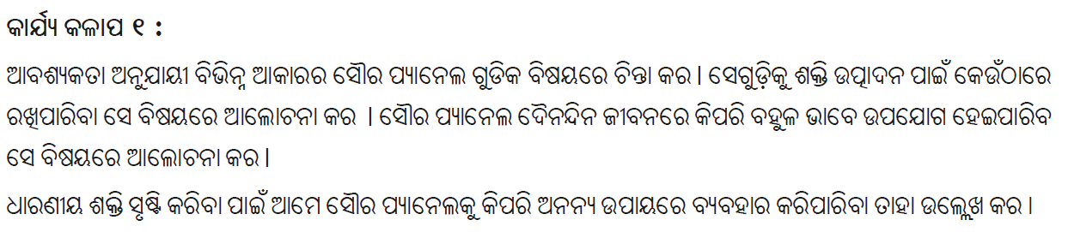

Slide 25

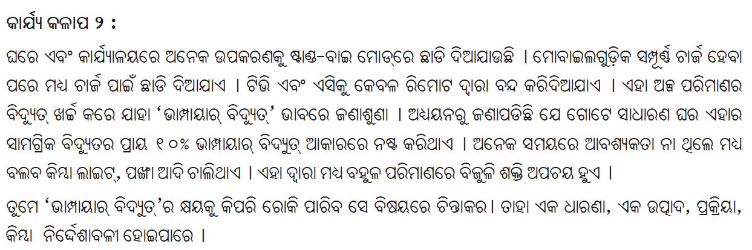

Slide 26

THANK YOU!
All the best Jigyansa Teachers.

